Slide 1
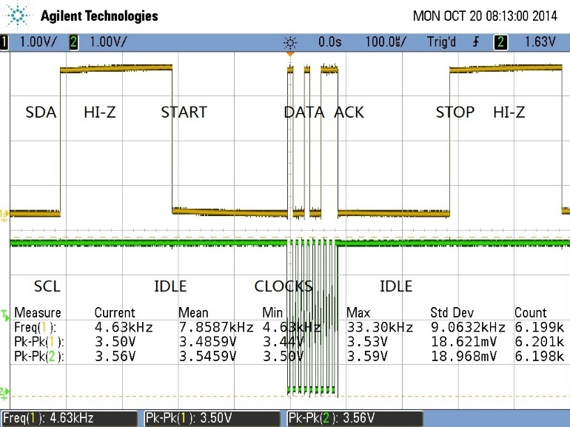

Lecture 3-1 I2C Controller in Verilog, Lab #2 Phase I
I2C Introduction
I2C Module of PIC16F887
I2C Master Module
Lab #2 Phase 1: A Simplified Master Module Design
Top Level Circuit
Data Unit: Baud rate generator, Shift Register and SDA Module
Tri-State Buffer in Verilog
I2C Master Controller
Sample I2C Waveforms

Slide 2
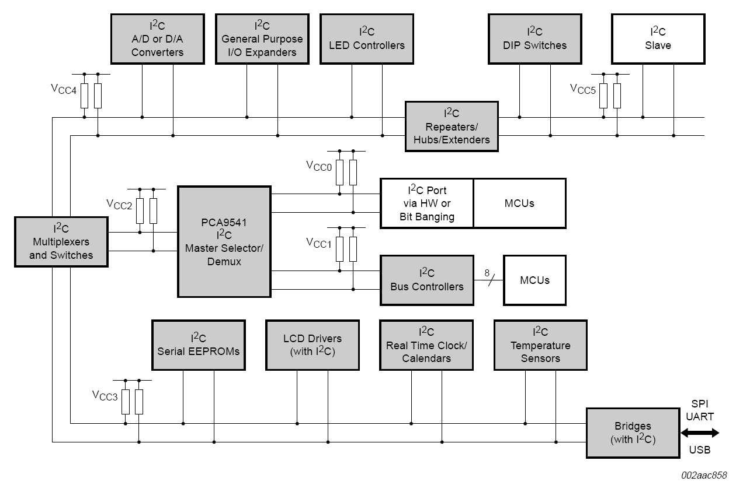
I2C Example Application
http://i2c.info/i2c-bus-specification

Slide 3
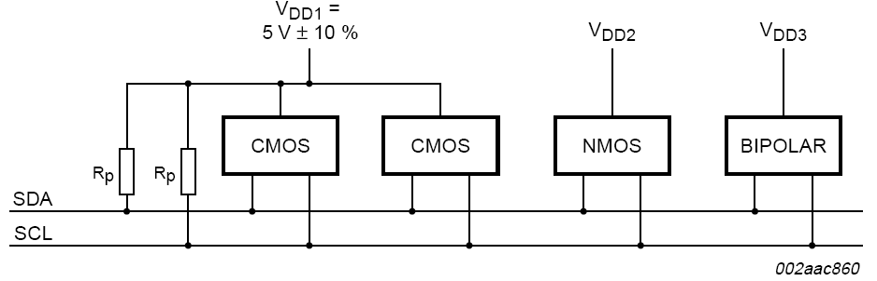
I2C is a 2-Wire Serial Bus (plus the common voltage reference wire)
SDA – Serial Data Line
SCL – Serial Clock Line
Ground – common voltage reference line
Two pull-up resistors of 4.7kΩ
Both SDA and SCL are open drain or open collector to appear to be high-impedance, Hi-Z, when not active

Slide 4
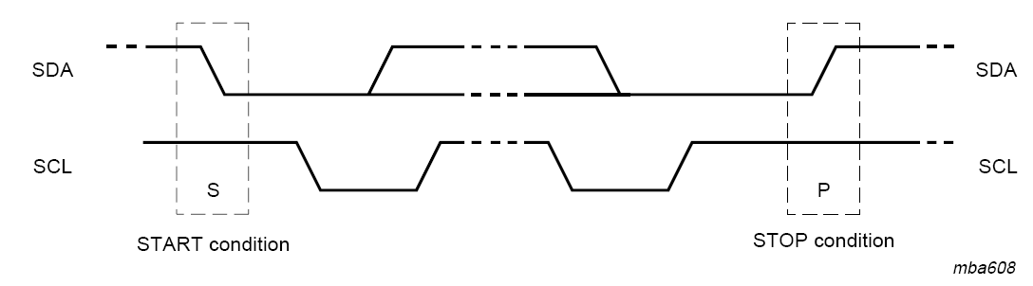
Start and Stop Conditions
Start condition is when SCL=1 and SDA goes from 1 to 0
Stop condition is when SCL=1 and SDA goes from 0 to 1
Notice data line SDA cannot change when SCL=1 to set data values because SDA change indicates Start or Stop when SCL=1.

Slide 5
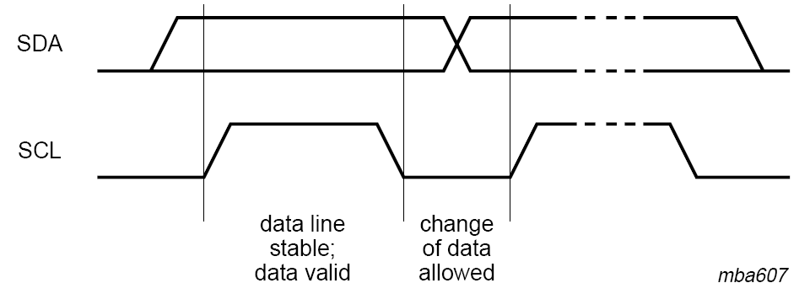
Data Validity
SDA line can set up data values to be transferred when clock line SCL is low, i.e., “0”.
Sampling point at a receiver is on positive or rising edge

Slide 6
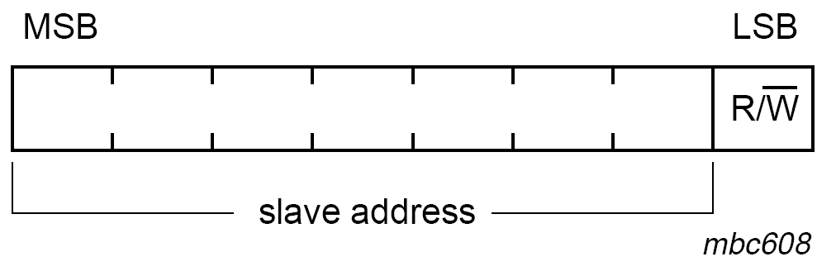
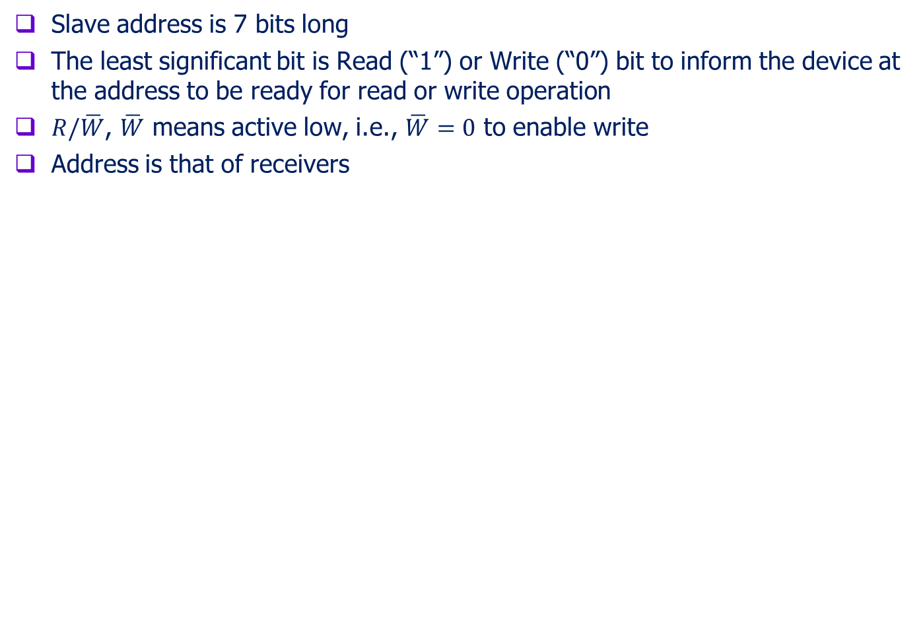
The First Byte Is Composed of 7-bit Address and $R/\overline{W}$ bit
Slave address is 7 bits long
The least significant bit is Read (“1”) or Write (“0”) bit to inform the device at the address to be ready for read or write operation
$R/\overline{W}$, $\overline{W}$ means active low, i.e., $\overline{W}=0$ to enable write
Address is that of receivers

Slide 7
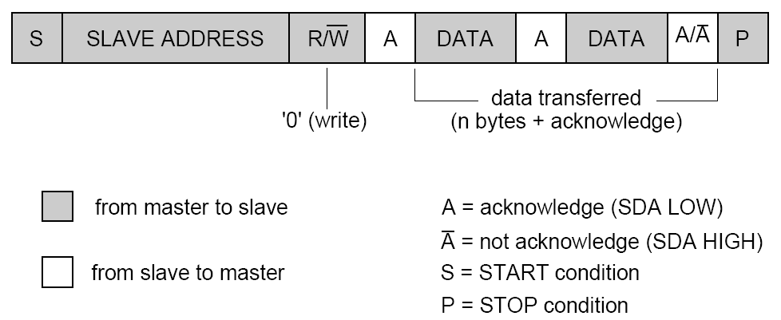
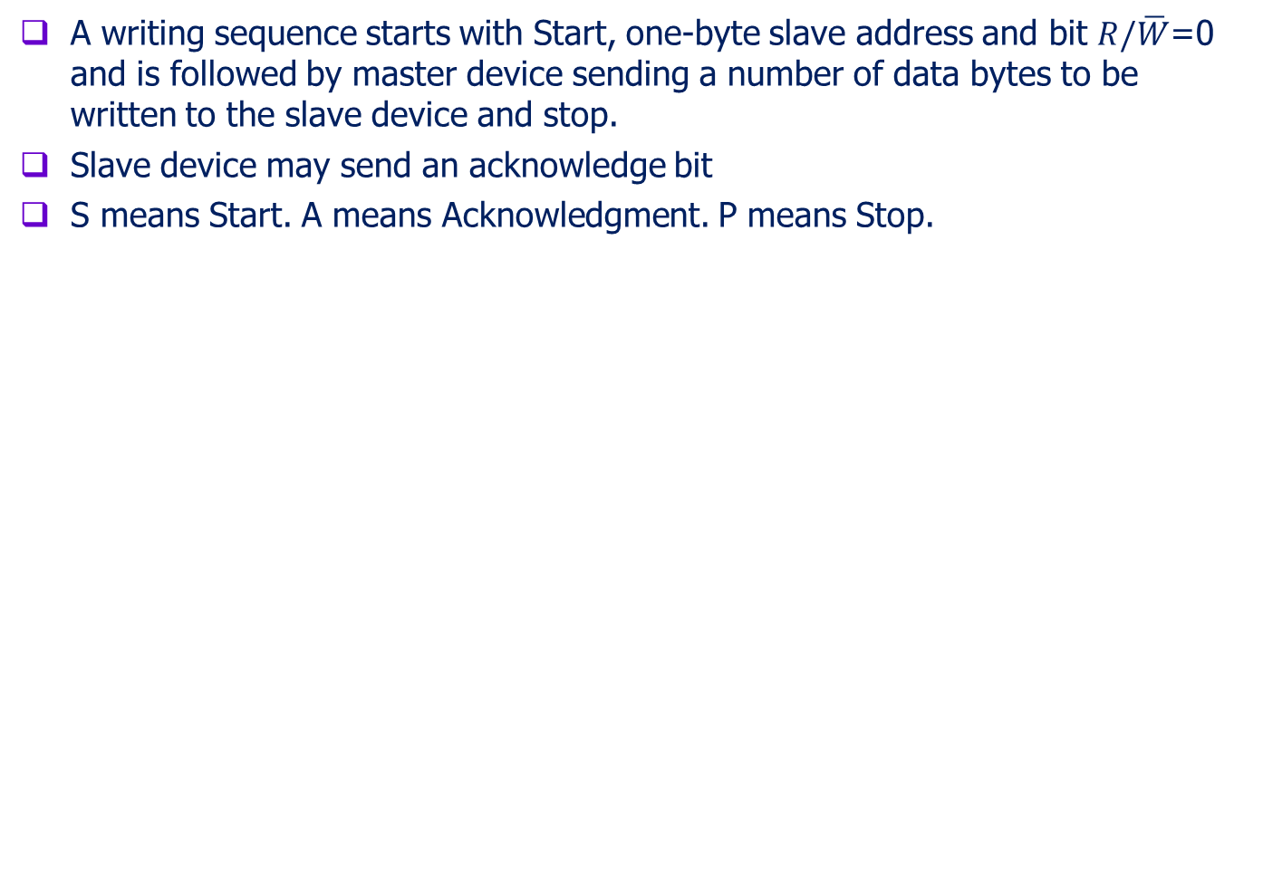
To Write to A Slave Device
A writing sequence starts with Start, one-byte slave address and bit $R/\overline{W}$=0 and is followed by master device sending a number of data bytes to be written to the slave device and stop.
Slave device may send an acknowledge bit
S means Start. A means Acknowledgment. P means Stop.

Slide 8
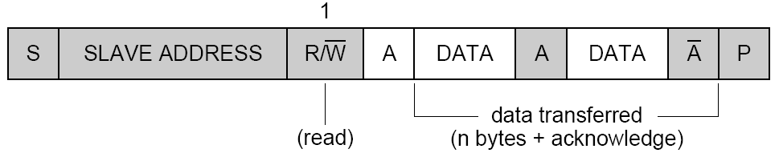
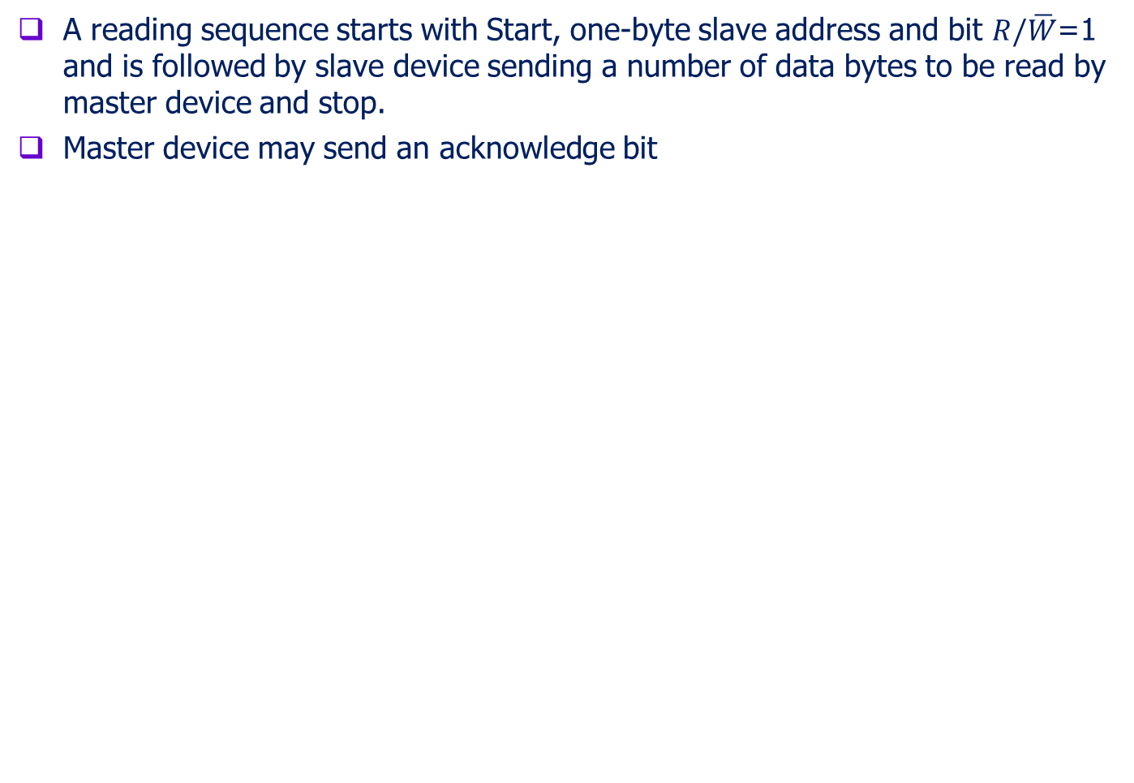
To Read from A Slave Device
A reading sequence starts with Start, one-byte slave address and bit $R/\overline{W}$=1 and is followed by slave device sending a number of data bytes to be read by master device and stop.
Master device may send an acknowledge bit

Slide 9
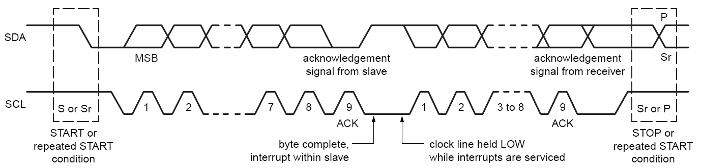
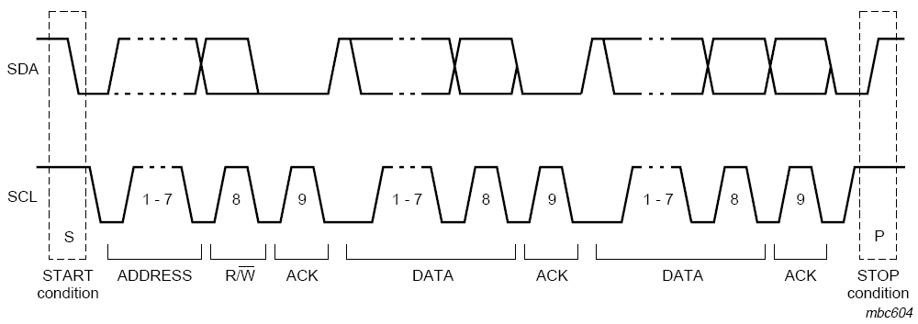
I2C Data Transfer
I2C bus is idle when both SDA and SCL are high “1” or hi-Z
Data transfer starts after Start Bit appears
Each frame after Start Bit is 9 bits long: eight-bit data and one-bit acknowledgement
First frame is 7-bit address with read/write (Read=1 and Write=0)
The most-significant bit (MSB) is sent first, triggered on positive edge
Data transfer may continue until Stop Bit appears

Slide 10

Example to Send Address 7’b1001001 and Read

Slide 11
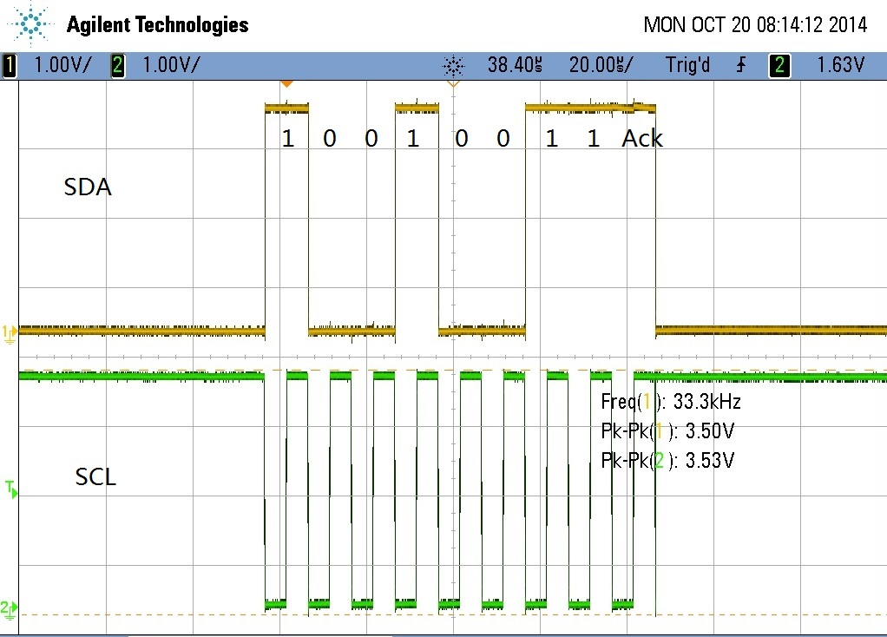
Example to Send Address 7’b1001001 and Read

Slide 12
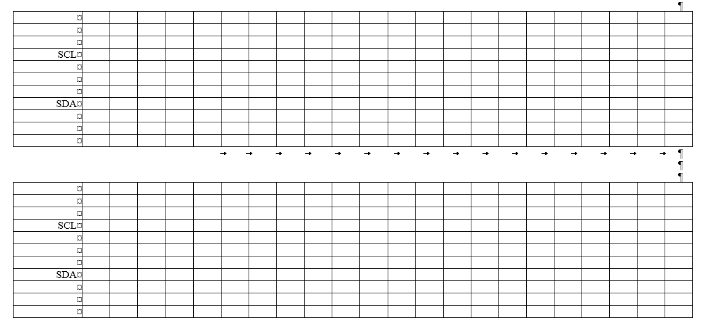
Exercise: Draw SDA and SCL waveforms to send 8’b01011101.

Slide 13
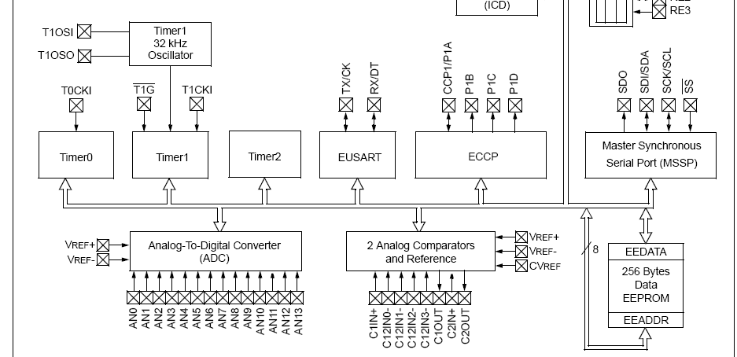
I2C Module of PIC16F887
Microcontrollers have hardware modules that are independent of their CPUs
I2C module is one of the hardware modules of PIC16F887 microcontroller
The module can also be configured as SPI module

Slide 14
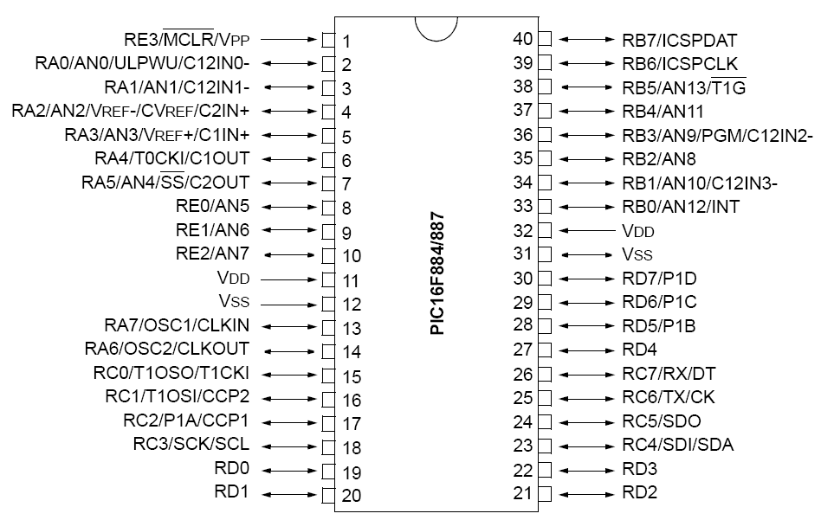
I/O Pins RC3 (Serial Clock) and RC4 (Serial Data)
Two pin interface plus V_{ss} for ground reference

Slide 15
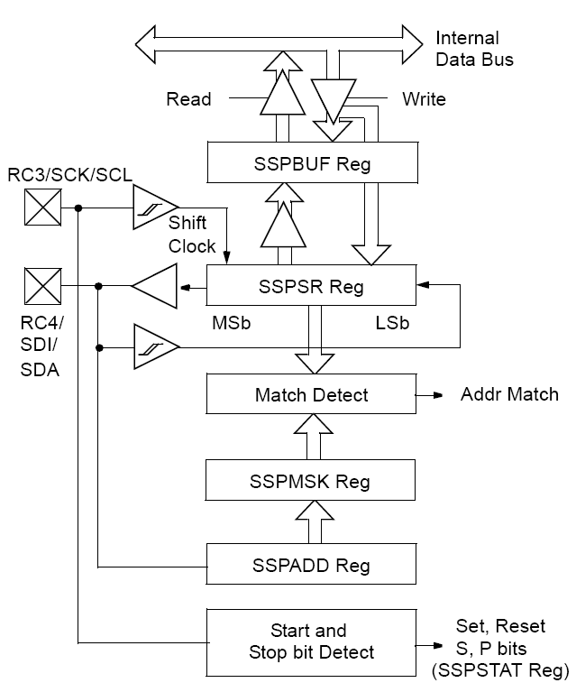
Internal Structure of I2C Module of PIC16F887
SSPBUF Reg – Buffer
SSPSR Reg – Shift Register
Functions needed if PIC16F887 works as a slave device
Address Match Detect
Start and Stop bit detect

Slide 16
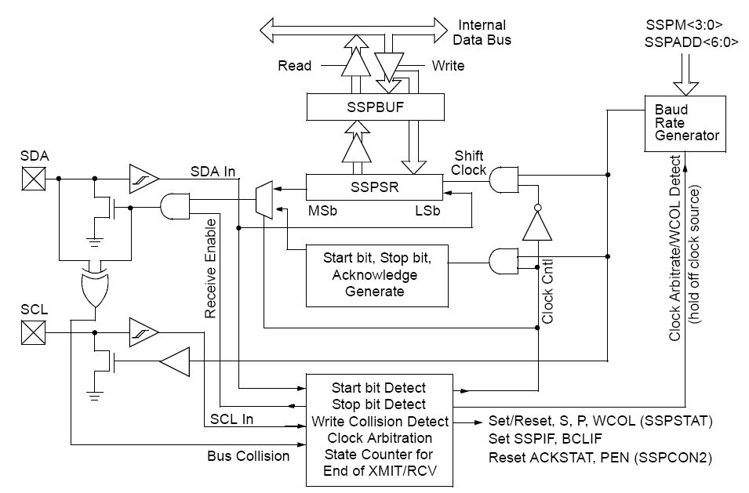
Sender Control Mode of PIC16F887 I2C Module
SDA – serial data line, tri-state, bidirectional
SCL – serial clock line, tri-state, bidirectional
Baud Rate Generator
Start, Stop bit, acknowledge bit generation
Collision Detect

Slide 17
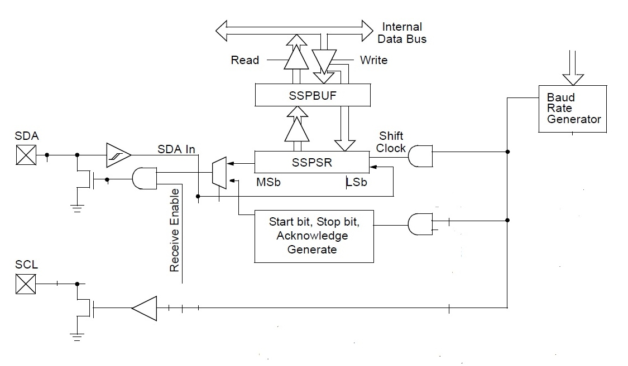
Lab #2 Phase 1: A Simplified Sender Module Design
Assert a Start condition on SDA and SCL.
Write to the SSPBUF register to initiate transmission of data/address.
Generate a Stop condition on SDA and SCL.
Configure the I2C port to receive data.
Generate an Acknowledge condition at the end of a received byte of data.
Baud Rare =20kHz

Slide 18
Sender Module Write/Read Transmit Sequence
Initial
Generate a Start condition and switch SDA to output
Wait the required start time before any other operation takes place.
Loads the SSPBUF with the address to transmit.
Address is shifted out the SDA pin until all eight bits are transmitted.
Receive the ACK bit from the slave device.
Write
Load the SSPBUF with eight bits of data.
Data is shifted out the SDA pin until all eight bits are transmitted.
Receive the ACK bit from the slave device
Generate a Stop condition.
Read
Switch SDA to input
Data is shifted in the SDA pin until all eight bits are received.
Send the ACK bit to the slave device
Generate a Stop condition.

Slide 19
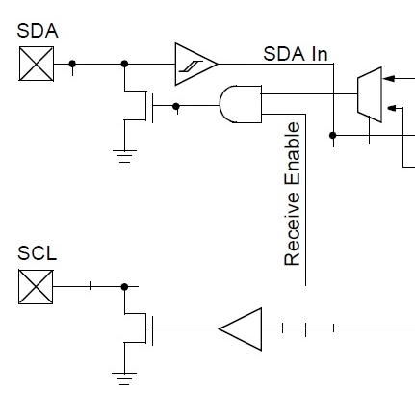
A Simplified I2C Sender Data Unit Design and Controller
Data Unit modules
Controller Requirements
15kHz
Baud Rate
Generator
Idle High
Data
Baud Clock
Write Load
ShiftorHold
8-bit Shift
Register
Baud Clock Enable
SDA
Tri-State
Bidirectional
Start
Stop
Acknowledge
Tri-state
Enable
1
0
ReadOrWrite
(0 to write)
Select
StartStopAck
SCL
Baud Clock
60MHz System Clock

Slide 20
Design Principles
Data unit and controller
Simulation and simulation
Use off-shelf components
Make standard components
Object-oriented approach
No computer game approach – keep doing miss and hit
No big bang approach – keep making a bowl of spaghetti

Slide 21
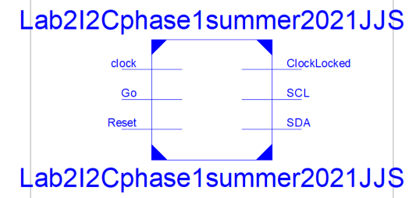
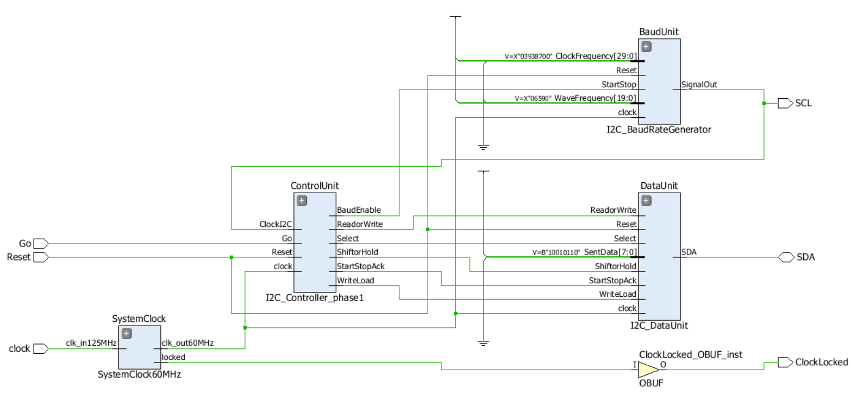
Lab #2 Phase I: Top Level Circuit
Top Module
Controller
Data Unit
Clock

Slide 22
Lab #2 Phase 1: Included Files and template Files
Most circuit files and all test bench files for Lab #2 Phase 1 are provided by the instructor
Two modules need to be developed by the students with their template files provided by the instructor
I2C_SDAmoduel.v
I2C_Controller_phase1.v
These two new circuits must be simulated to verify their correctness
Submit your simulation waveforms
The top-level circuit must be implemented on your Zybo board to obtain I2C waveforms on an oscilloscope
Submit your screen captures or photos of your I2C waveforms

Slide 23
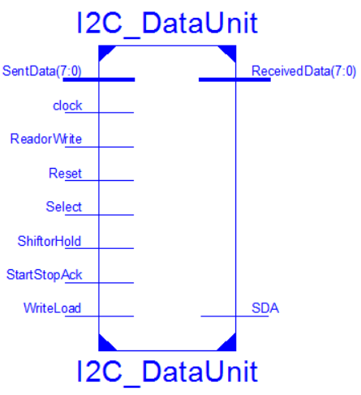
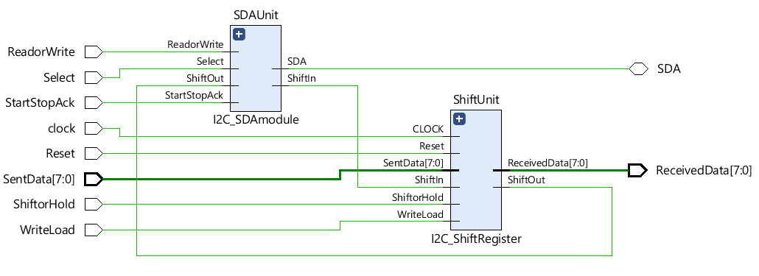
Lab #2 Phase I: Data Unit
Baud Rate Generator
Data Shift Register
SDA Signal Generator
Start
Stop

Slide 24
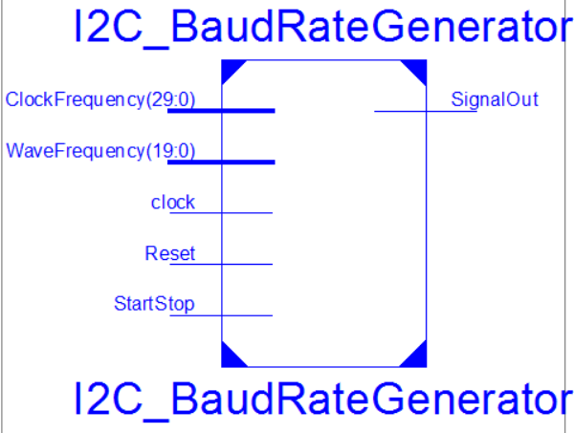
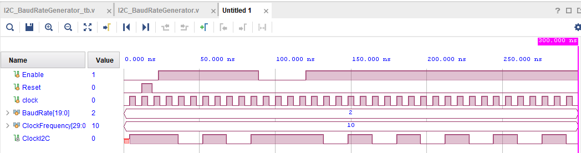
Baud Rate Generator
Enable pin is “0” to clear Baud Rate Counter and Set ClockI2C. Enable becomes active to clear ClockI2C to start the I2C clock on negative edge.
BaudRate is the I2C speed value in Hz
ClockFrequency is the system clock value in Hz
Clock is system clock
Enable = 1 to generate I2C clock on ClockI2C
Enable = 0 to make I2C clock logic “high” on ClockI2C=1

Slide 25
Lab #2 Phase I: A Generic Square Wave Module
A Enable pin is “0” to clear Baud Rate Counter and Set ClockI2C. Enable becomes active to clear ClockI2C to start the I2C clock on negative edge.
BaudRate is the I2C speed value in Hz
ClockFrequency is the system clock value in Hz
Clock is system clock
Enable = 1 to generate I2C clock on ClockI2C
Enable = 0 to make I2C clock logic “high” on ClockI2C=1

Slide 26
Lab #2 Phase I: A Square Wave Generator
module I2C_BaudRateGenerator (WaveFrequency, ClockFrequency, StartStop, SignalOut, Reset, clock);
input StartStop, Reset, clock;
input [19:0] WaveFrequency; //up to 1,000,000
input [29:0] ClockFrequency; //up to 1GHz
output reg SignalOut;
reg [15:0] baud_count;
always @(posedge clock)
if(Reset==1) begin baud_count <= 16'b0;
SignalOut <= 1'b1; //idle is "1“ end
else
case (StartStop)
1'b0: begin SignalOut <= 1'b1; baud_count <= 16'b0; end
1'b1: if (baud_count < (ClockFrequency/(WaveFrequency*2)-1))
begin
baud_count <= baud_count + 1'b1;
SignalOut <= SignalOut;
end
else
begin baud_count <= 16'b0; SignalOut <= ~SignalOut; end
endcase
endmodule

Slide 27
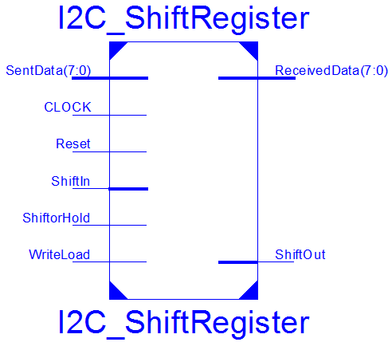
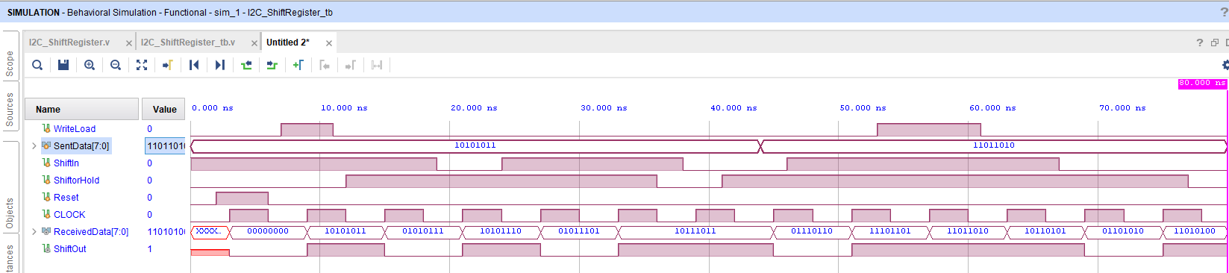
8-bit Shift Register for I2C Data Unit
SentData to write a byte
ReceivedData to read a byte
ShiftIn is a serial input of shift register
ShiftOut is a serial output of shift register
ShiftClock is the I2C clock
ShiftorHold controls shift or hold action
WriteLoad=1 to parallel load SentData into shift register
Both loading and Shifting occurs when I2C clock is low, which will generate a negative one-shot.

Slide 28
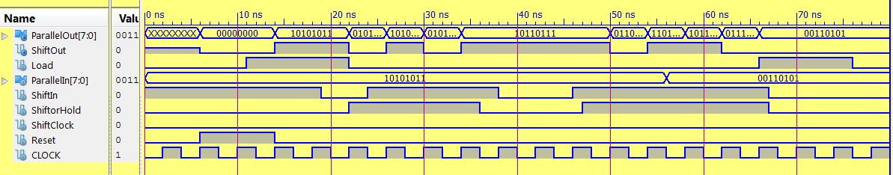
Lab #2 Phase I: A Generic 8-bit Shift Register
Generic Shift Register
8-bit Parallel in and out ports
1-bit serial shift in and out pins
Load =1 to parallel load
ShiftorHold=1 to shift and 0 to hold

Slide 29
Lab #2 Phase I: I2C_ShiftRegister()
module I2C_ShiftRegister #(parameter LENGTH = 8)(
input WriteLoad, ShiftorHold, Reset, CLOCK, ShiftIn,
input [LENGTH-1:0] SentData,
output ShiftOut,
output [LENGTH-1:0] ReceivedData);
reg [LENGTH-1:0] ShiftRegister;
assign ShiftOut = ShiftRegister[LENGTH-1];
assign ReceivedData = ShiftRegister;
always @ (posedge CLOCK)
if(Reset==1) ShiftRegister <= 0;
else
if(WriteLoad==1) //parallel load
ShiftRegister <= SentData;
else
case (ShiftorHold)
1'b1: ShiftRegister <= {ShiftRegister[LENGTH-2:0],ShiftIn}; //shift
default: ShiftRegister <= ShiftRegister; // hold
endcase
endmodule

Slide 30
Lab #2 Phase I: Test Bench for I2C_ShiftRegister()
`timescale 1ns / 1ps
module I2C_ShiftRegister_tb;
reg WriteLoad, ShiftIn, ShiftorHold, Reset, CLOCK;
reg [7:0] SentData;
wire [7:0] ReceivedData;
wire ShiftOut;
I2C_ShiftRegister uut (WriteLoad, ShiftorHold, Reset, CLOCK, ShiftIn, SentData, ShiftOut,ReceivedData);
initial begin WriteLoad = 0; SentData = 0; ShiftIn = 0; ShiftorHold = 0; Reset = 0; CLOCK = 0; end
always #3 CLOCK=~CLOCK;
initial fork
#0 Reset = 0; #2 Reset = 1; #6 Reset = 0;
#0 WriteLoad = 0; #7 WriteLoad = 1; #11 WriteLoad = 0; #53 WriteLoad = 1; #61 WriteLoad = 0;
#0 SentData = 8'b10101011; #44 SentData = 8'b11011010;
#0 ShiftIn = 1; #13 ShiftIn = 1; #19 ShiftIn = 0; #24 ShiftIn = 1; #38 ShiftIn = 0; #46 ShiftIn = 1;
#67 ShiftIn = 0; #98 ShiftIn = 1;
#0 ShiftorHold = 0; #12 ShiftorHold = 1; #36 ShiftorHold = 0;
#41 ShiftorHold = 1; #77 ShiftorHold = 0;
#80 $stop;
join
endmodule

Slide 31
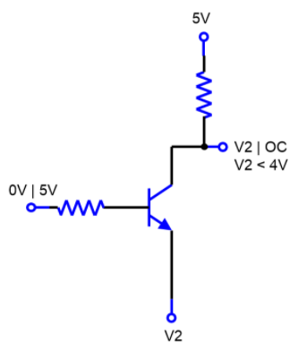
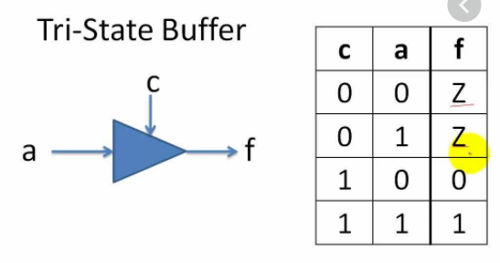
Tri-State and Bidirectional Buffers
What is tri-state? - Logic 1, Logic 0, Hi-Z (High Impedance, Open Circuit)
Why is it used?

Slide 32
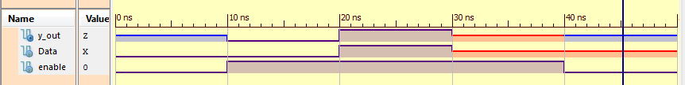
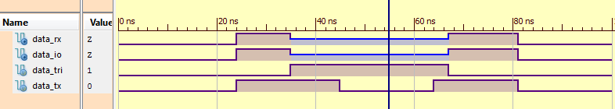
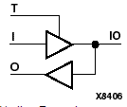
Tri-State and Bidirectional Buffers
``timescale 1ns / 1ps
module TriState(
input Data, enable,
output y_out
);
assign y_out = enable?Data:1'bz;
endmodule
`timescale 1ns / 1ps
module bidirectional (data_tri, data_rx, data_tx data_io);
input data_tri; //control signal. T
inout data_io; //IO
output data_rx; //received data
Input data_tx; //transmitted data
assign data_io = (data_tri) ? 1'bZ:data_tx;
assign data_rx = data_io;
endmodule

Slide 33
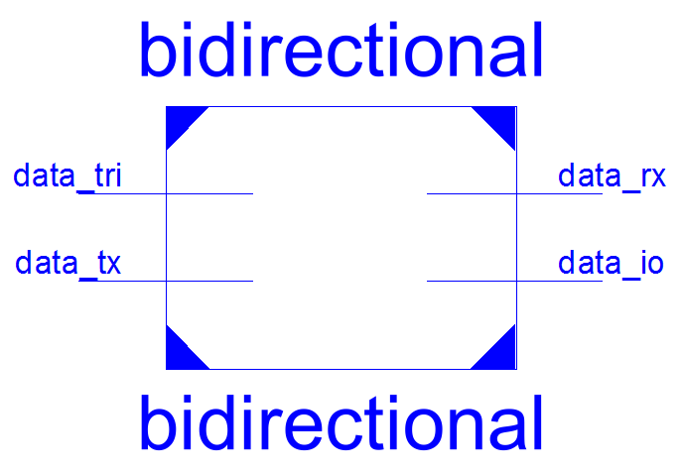
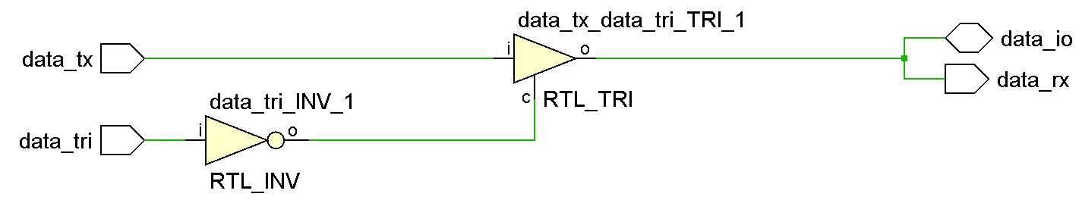
Bidirectional Buffers
`timescale 1ns / 1ps
module bidirectional (data_tri, data_tx, data_rx, data_io);
input data_tri; //control signal
input data_tx; //transmitted data
inout data_io; //bidirectional pin
output data_rx; //received data
assign data_io = (data_tri) ? 1'bZ:data_tx;
assign data_rx = data_io;
endmodule

Slide 34
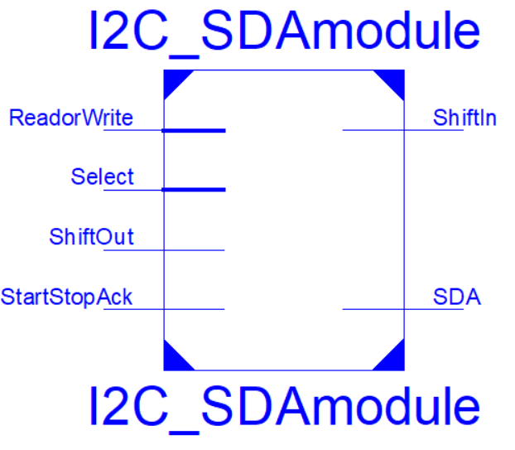
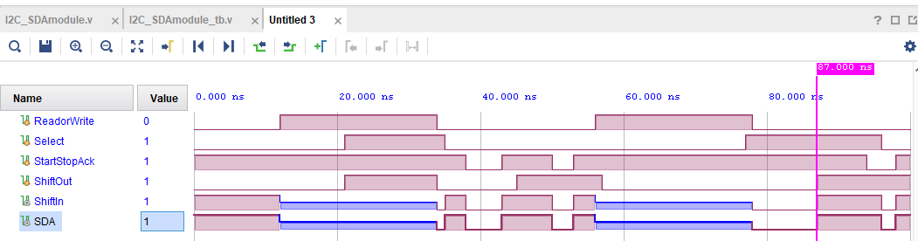
SDA Module
SDA is tri-state and bidirectional
Select chooses StopStartAck or ShiftOut to be sent to SDA
ReadorWrite selects Read (==1) or Write (==0) operation
SDA is Hi-Z on Read operation
ShiftIn is an input from SDA
ShiftOut is an output to SDA

Slide 35
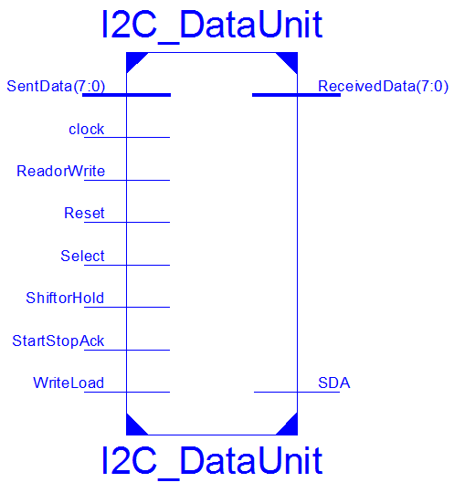
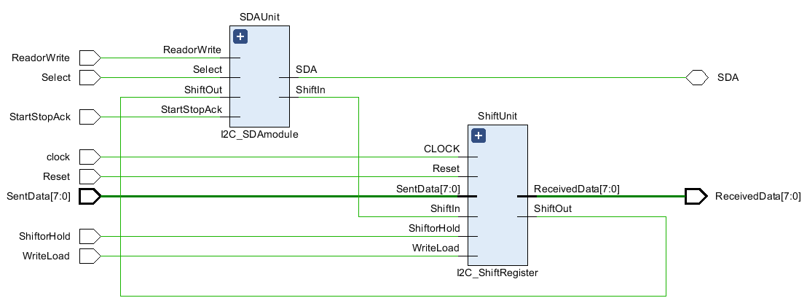
Simulation of Sender I2C Data Unit Module

Slide 36
//File Name: I2C_DataUnit.v
//Author: Jianjian Song
//Date: November 2021
//HUST Summer 2021
//Data Unit for I2C Master Circuit
//ReadorWrite==1 to read
//ReadorWrite==0 to write
module I2C_DataUnit (WriteLoad, ReadorWrite, ShiftorHold, Select, SentData,
ReceivedData, SDA, StartStopAck, Reset, clock);
parameter LENGTH = 8;
input WriteLoad, ReadorWrite, ShiftorHold, Select, StartStopAck;
inout SDA;
input Reset, clock;
input [LENGTH-1:0] SentData;
output [LENGTH-1:0] ReceivedData;
//module I2C_ShiftRegister(WriteLoad, SentData, ReceivedData,ShiftIn,ShiftOut,ShiftorHold,Reset,CLOCK) ;
wire ShiftDataIn, ShiftDataOut;
I2C_ShiftRegister ShiftUnit(WriteLoad, SentData, ReceivedData,ShiftDataIn, ShiftDataOut,ShiftorHold, Reset,clock) ;
//module I2C_SDAmodule(SDA, ReadorWrite, Select, StartStopAck, ShiftIn, ShiftOut) ;
I2C_SDAmodule SDAUnit(SDA, ReadorWrite, Select, StartStopAck, ShiftDataIn, ShiftDataOut) ;
endmodule

Slide 37
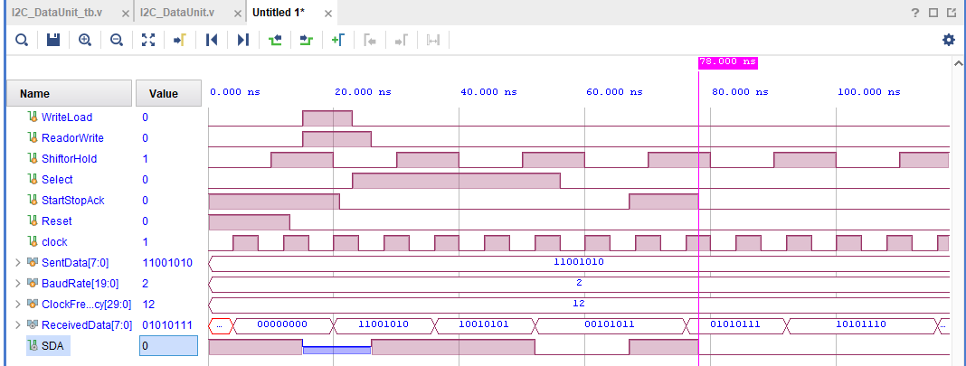
Simulation of Sender I2C Data Unit Module

Slide 38
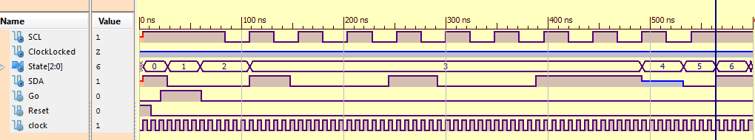
Lab #2 Phase I: Counter to keep track of the number of SCL cycles
//A separate counter is used to track the number of SCL clock cycles so that 9 cycles will be generated.
//First cycle is from Load State, next seven are from Write State, the last one is from Acknowledgment
always@(posedge clock)
if(Reset==1) begin DataCounter<=4'd9; end
else
case (State)
LoadState: if(OneShotI2C==0) DataCounter<=DataCounter-1; else DataCounter<=DataCounter;
WriteState: if(OneShotI2C==0) DataCounter<=DataCounter-1; else DataCounter<=DataCounter;
default: DataCounter<=4'd9;
endcase

Slide 39
A Simplified I2C Sender Data Unit Design and Controller
Data Unit modules
Controller Requirements
15kHz
Baud Rate
Generator
Idle High
Data
Baud Clock
Write Load
ShiftorHold
8-bit Shift
Register
Baud Clock Enable
SDA
Tri-State
Bidirectional
Start
Stop
Acknowledge
Tri-state
Enable
1
0
ReadOrWrite
(0 to write)
Select
StartStopAck
SCL
Baud Clock
60MHz System Clock

Slide 40
Lab #2 Phase I: Controller Design

Slide 41
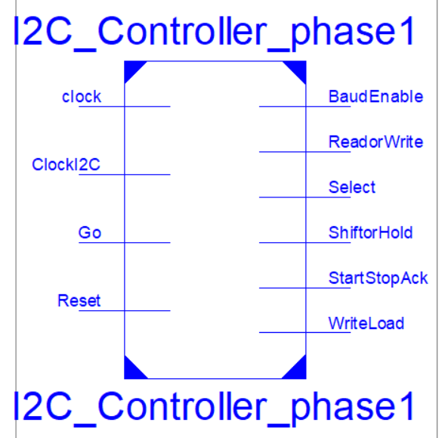
Lab #2 Phase I: Controller Design
ReadorWrite=1 to read and
ReadorWrite= 0 to write
Select=1 to choose shift register
Select=0 to choose Start, Stop and Ack
ShiftorHold=1 to shift
ShiftorHold=0 to hold
Start
Send 8-bit data
Acknowledgement
Stop
Go=1 to start I2C signals
Go=0 to start at Initial State
TimeOut=1 to show end of delay loop
WriteLoad=1 to load shift register with data to be sent
BaudEnable=1 to generate I2C clock

Slide 42
Lab #2 Phase I: Master Module Controller to Send First Byte (Ver 4.0, page 1)
Initial State
Start State
No
BaudRateEnable=0
ReadorWrite=0
Write Load=0
Select=0
ShiftorHold=0
StartStopAck=0
Count=10
StartTimer=Yes
BaudRateEnable=0
ReadorWrite=0
Write Load=0
Select=0
ShiftorHold=0
StartStopAck=1
Count=10
StartTimer=No
Low
TimeOut
High
SCL
Yes
Load Shift Reg
BaudRateEnable=1
ReadorWrite=0
WriteLoad=1
Select=0
ShiftorHold=0
StartStopAck=0
On SCL negedge: Count= Count-1
StartTimer=No
Write State
BaudRateEnable=1
ReadorWrite=0
Write Load=0
Select=1
ShiftorHold=NegativeSCLedge
StartStopAck=0
On SCL negedge: Count= Count-1
StartTimer=No
Yes
Start
No
Yes
No
Count decrements on negative edges of SCL clock for writing
Count==9
No
Yes
Stay in Load until SCL has started
Next page
Count==1
StartTimer=0 to start delay timer, i.e., No=1 and Yes=0

Slide 43
Lab #2 Phase I: Master Module Controller to Send First Byte (Ver 4.0, page 2)
Transit
Baud Rate Enable=0
ReadorWrite=0
Write Load=0
Select=0
ShiftorHold=0
StartStopAck=0
Count=10
StartTimer=Yes
Receive
Acknowledge
No
Baud Rate Enable=1
ReadorWrite=1
Write Load=0
Select=0
ShiftorHold=0
StartStopAck=0
Count=10
StartTimer=No
Positive SCL edge
Yes
No
TimeOut
From
1st page
Yes
Stop
Baud Rate Enable=0
ReadorWrite=0
Write Load=0
Select=0
ShiftorHold=0
StartStopAck=1
Count=10
StartTimer=Yes
ReadorWrite=1 to read, 0 to write
Select=1 to choose shift register
Select=0 to choose Start, Stop and Ack
ShiftorHold=1 to shift, 0 to hold
StartTimer=0 to start delay timer
No=1, Yes=0
Initial State
Yes
No
TimeOut

Slide 44
Lab #2 Phase I: Count Update State Machine
Reset
Default State
Write State
Count=10
Count=10
Count= Count
Load State
SCL negative edge
No
Count= Count
Yes
Count= Count-1
No
SCL negative edge
//counting the number of shifts
always@(posedge clock)
if(Reset==1) begin DataCounter<=4'd10; end else
case (State)
LoadState: if(OneShotI2Cnegative==1) DataCounter<=DataCounter-1'b1; else DataCounter<=DataCounter;
WriteState: if(OneShotI2Cnegative==1) DataCounter<=DataCounter-1'b1; else DataCounter<=DataCounter;
default: DataCounter<=4'd10;
endcase
Yes
Count= Count-1

Slide 45
Lab #2 Phase I: Delay Timer
Reset
Count=0
TimeOut=0
module DelayTime(input Reset, Clock, Start, output reg Timeout);
//for simulation
//parameter Divider = 3;
//for board implementation
parameter MaxCount = 10000;
parameter NumberOfBits = 20;
reg [NumberOfBits-1:0] count;
always @ (count)
if(count==MaxCount) Timeout<=1;
else Timeout<=0;
always @ (posedge Clock)
if(Reset==1) count<=0; else
if(Start==1) begin count <= 0; end
else if (count>=MaxCount) count<=0;
else count <= count+1'b1;
endmodule
Wait State
Count=0
TimeOut t=0
No
StartTimer=1
Yes
Count-Up State
Count= Count-1
TimeOut =0
No
Count=Max
Timeout State
Yes
Count=0
TimeOut =1

Slide 46
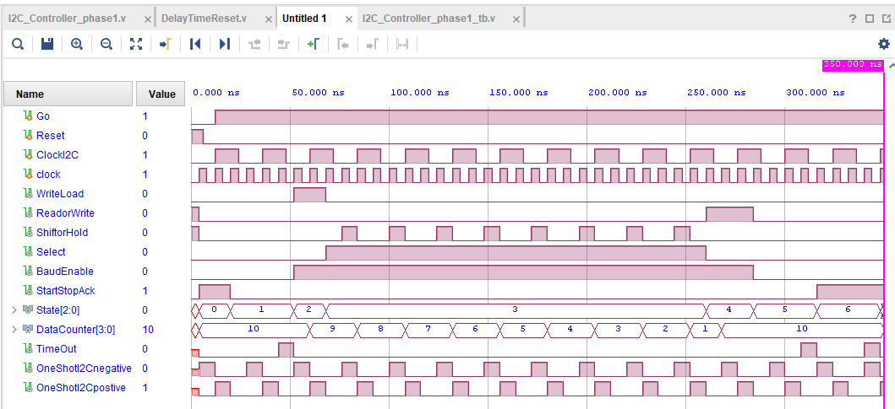
Lab #2 Phase I: Controller Simulation
ReadorWrite=1 to read and
ReadorWrite= 0 to write
Select=1 to choose shift register
Select=0 to choose Start, Stop and Ack
ShiftorHold=1 to shift
ShiftorHold=0 to hold
Go=1 to start I2C signals
Go=0 to start at Initial State
TimeOut=1 to show end of delay loop
WriteLoad=1 to load shift register with data to be sent
BaudEnable=1 to generate I2C clock

Slide 47
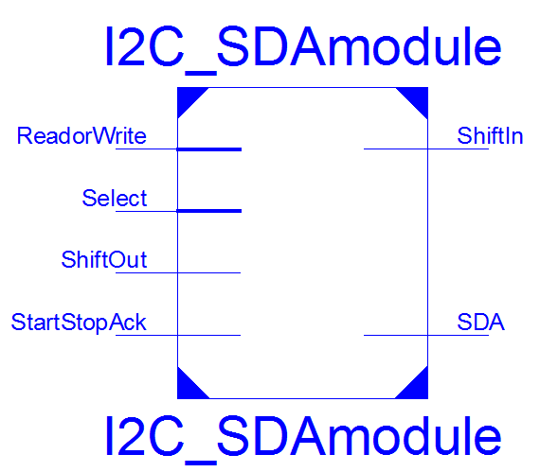
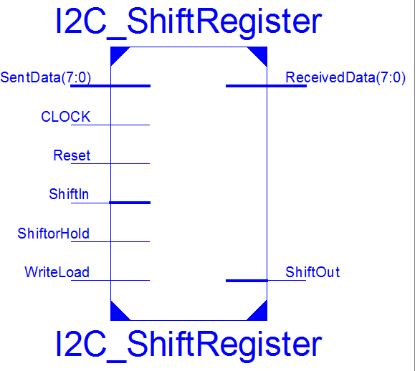
Lab #2 Phase I: Test Bench for Controller Simulation
`timescale 1ns / 1ps
module I2C_Controller_phase1_tb;
reg Go,Reset,ClockI2C,clock;
wire WriteLoad, ReadorWrite, ShiftorHold, Select, BaudEnable, StartStopAck;
wire [2:0] State=uut.State;
wire [3:0] DataCounter=uut.DataCounter;
wire TimeOut=uut.TimeOut;
wire OneShotI2Cnegative=uut.OneShotI2Cnegative;
wire OneShotI2Cpostive=uut.OneShotI2Cpositive;
I2C_Controller_phase1 uut (Reset, clock, Go, ClockI2C, WriteLoad,
ReadorWrite, ShiftorHold, Select, BaudEnable, StartStopAck);
initial begin Go = 0; Reset = 0; ClockI2C = 0; clock = 0; end
always #4 clock=~clock;
always #12 ClockI2C=~ClockI2C;
initial fork
#0 Go = 0; #12 Go = 1;
#0 Reset = 1; #6 Reset = 0;
#350 $stop;
join
endmodule

Slide 48
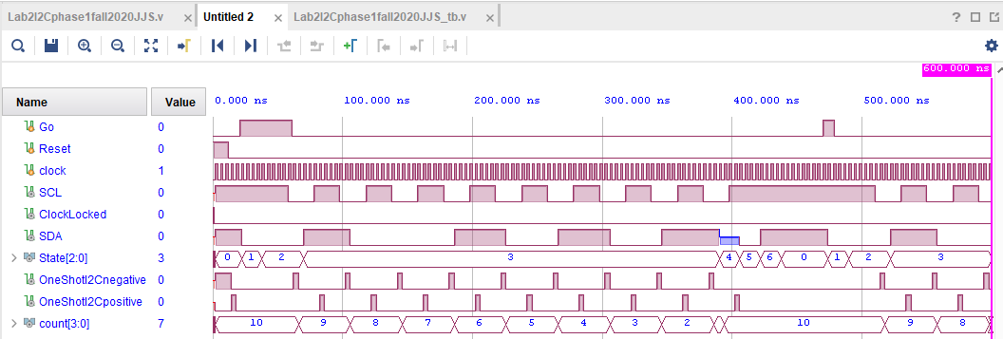
Lab #2 Phase I: Top Level Circuit Simulation
Four logic value simulation:
Logic 1, Logic 0, Unknown or Don’t Care X, and High-Z

Slide 49
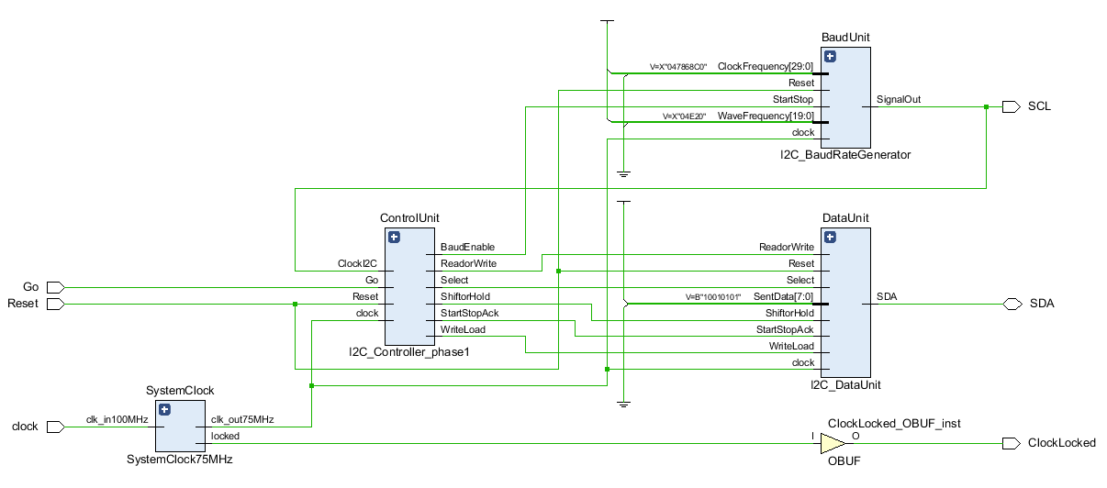
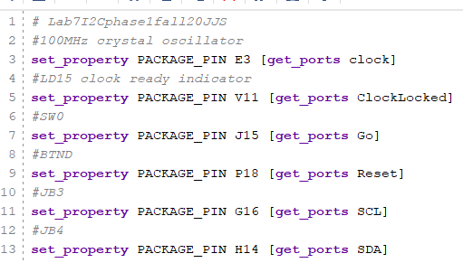

Lab #2 Phase I: Top Level Circuit and its XDC File

Slide 50




Lab #2 Phase I SDA and SCL on Pmod Connectors on Zybo
TMP101 breakout board
Pin 1 SCL
Pin 2 SDA
Pin 3 GND
Pin 4 V+
125MHz Clock L16
JD6 JD5 JD4 (R14) JD3 (P14)
3.3V GND SDA SCL

Slide 51

Lab #2 Phase I: Measurement with EE Board and Zybo Board
Electronics Explorer Board (EE Board) from Digilent has an oscilloscope
Software WaveForms on a Windows system can talk to EE Board
Connect SDA and SCL pins to the oscilloscope of the EE Board to obtain their waveforms
Zybo board

Slide 52

Lab #2 Phase I: Sample Waveforms on Zybo Board
SDA is hi-z on idle; SCL is high on idle
First byte is 0b10010110

Slide 53

Lab #2 Phase I: Measurement with EE Board and Waveforms Software
Electronics Explorer Board (EE Board) from Digilent has an oscilloscope
Software WaveForms on a Windows system can talk to EE Board
Connect SDA and SCL pins to the oscilloscope of the EE Board to obtain their waveforms
Nexys A7 board

Slide 54

Lab #2 Phase I: Sample Waveforms on Nexys A7 Board
SDA is hi-z on idle; SCL is high on idle

Slide 55
Lab #2 Phase I: Sample Waveform
SDA is hi-z on idle; SCL is high on idle

Slide 56

Lab #2 Phase I: Sample Waveforms
Address = 0b1001001 $R/\overline{W}$=1 to read

Slide 57


Lab #2 Phase I: Sample Waveforms
Address = 0b10101101 $R/\overline{W}$=1 to read

